Slide 1
__ Hind Alamri
MTA Turnstile Data Analysis

Slide 2
Objective
Since the subway is very essential to NYC transport system and millions of people’s lives are connected to the subway system. But is the subway is safe ?

Slide 3
Methodology
Data sources + references:
- MTA Data
-NYPD Complaint Data Historic
Tools:
- Pandas, Numpy, Matplotlib, Seaborn, Datetime, and DB Browser

Slide 4
Methodology & Workflow
The Stations which are both exist in MTA Data and NYPD Complaint Data Historical.
The number of crimes in stations.
The relation between stations that have height entries and number of crime.
Total number of crimes per hour.

Slide 5


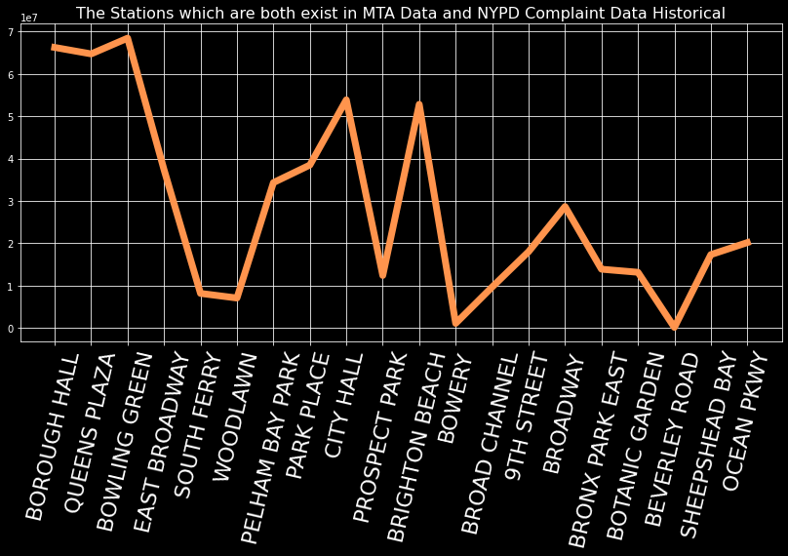

z

Slide 6
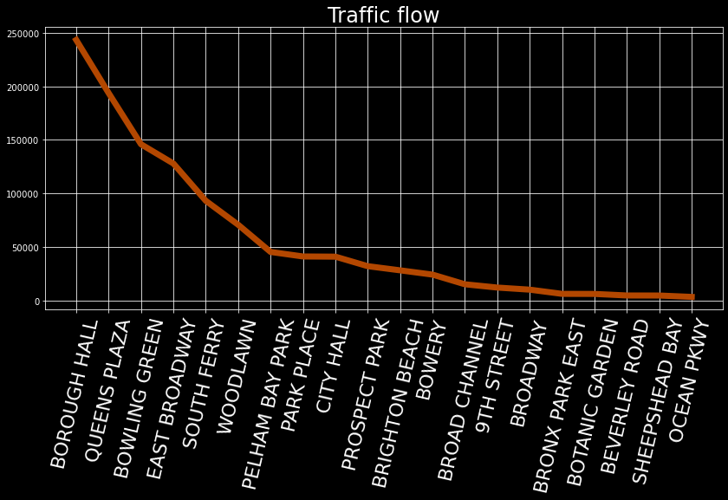

Slide 7
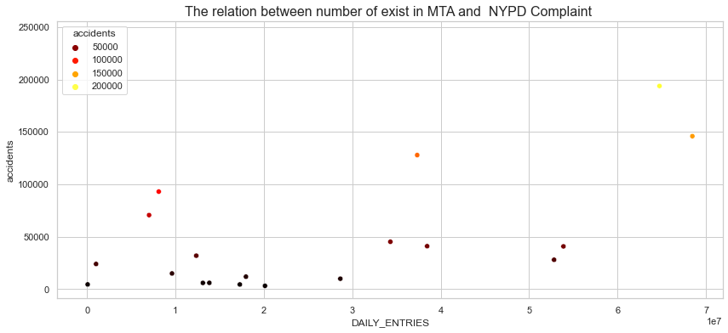

Slide 8
